Slide 1
BMW Sales Trends in the U.S.
A 2007-2016 sales analysis
By Stephanie Vaul

Slide 2
The Data Set
The proprietary sales data from most BMW centers in the U.S. going back 10 years.
Some of the main fields we’ll look at are:
Region (assigned by BMW based on dealership location, of which there are four)
PurchDate
VehYear
VehModel
VehECode (engine code assigned by BMW to categorize years & models)
NewUsed (New, Used, Other sale)
PurchType (Lease, Cash, Finance)
Gender

Slide 3
A look at the raw data
Gender
Very limited data available
Pay Type
How the customer is paid for the vehicle
All but 0.165% of data populated
Gender | Sales Count | % of Total | % of Specified
FEMALE | 194774 | 6% | 33%
MALE | 394286 | 11% | 67%
N/A | 2890455 | 83% | --
PayType | Sales Count | % of Total
Cash | 937642 | 27%
Finance | 1501621 | 43%
Lease | 1034526 | 30%
Only 17% have gender specified
1/3 of known buyers are female
2/3 of know buyers are male
Not adequate overall population
Majority finance
Still a high percentage of buyers pay in cash
Implies BMW purchases may be upper class with higher disposable income

Slide 4
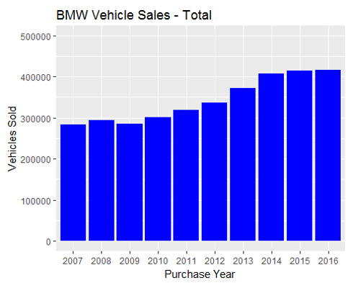
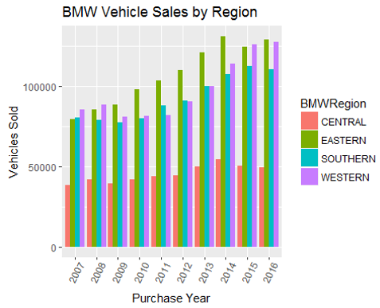
Total Sales by Purchase Year
National sales
Regional sales

Slide 5
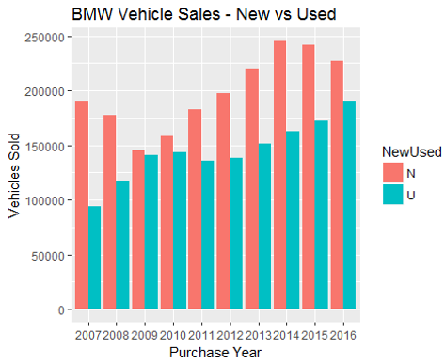
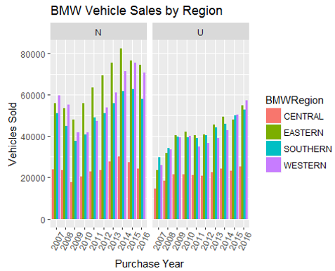
New vs Used Sales by Purchase Year
National sales
Regional sales

Slide 6
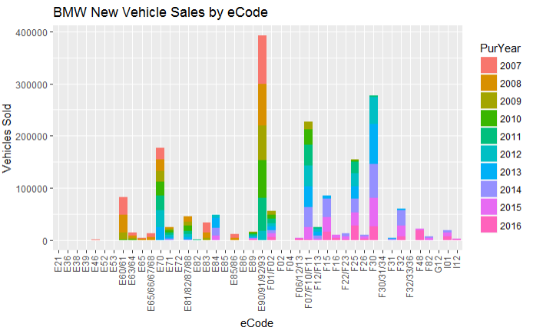
New Sales by eCode
eCode = BMW engine code
Groups similar models & years together
Visualization of how long each eCode was manufactured based on color and the sales volume based on bar height
Can be used to determine vehicle categories by cross-referencing the eCodes with model series & years
Two highest bars, E90/91/92/93 & F30, are both 3-series

Slide 7
eCodes to Vehicle Categories
eCode Groups | Model Years^ | Category Description | Total New Sales Count
E90/91/92/93 & F30 | 2005-2016 | 3-series sedans/coupes | 670080 (392370+277710)
F07/F10/F11 & E60/61 | 2003-2016 | 5-series sedans/coupes | 310819 (227741+83078)
E70, F15 & E53 | 2000-2016 | X5 SUV's | 262452 (176578+85157+717)
F25 & E83 | 2004-2016 | X3 SUV's | 154102
^ Since our data is based on New sales purchased from 2007 to 2016, for the most part, these counts represent 2007+ model years.
Allows assignment of Vehicle Category for these four most popular series
Remaining assigned to “Others”
Most popular 3-series outsold 2nd place, 5-series, by more than double over last 10 years
X5’s comprised 67% of the SUV sales, despite a higher price point

Slide 8
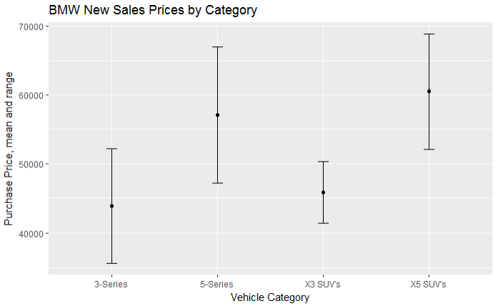
New Sales Purchase Price by Category
Many records had to be removed from the dataset in order to calculate the means
Lease payments
Trade-In values removed
Apparent invalid entries
Still left with a wide range of purchase prices within each series
X3’s have the narrowest price range
5-series have the widest price range
5-series and X5’s higher mean price than their 3-series and X3 counterparts
X3 and X5’s SUV’s higher mean that the 3- & 5-series sedans/coupes

Slide 9
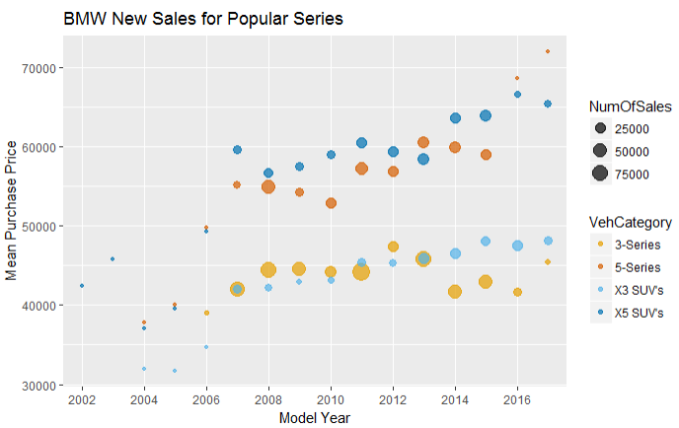
Popular Series: New Sales by Model Year
Color coding
Oranges = Sedans/Coupes
Blues = SUV’s
Mean price
drop in the sedan/coupes over last several years
SUV’s see a steady increase
2016 decrease in sedan/coupes in may be main cause of overall new sales drop in 2016

Slide 10
Predicting New BMW Sales – Supplementing with Economic Data
“Federal Reserve Economic Data” databases
Monthly statistics spanning the entire 10-year period from 2007 through 2016
Values gathered:
Prime Rate
48 month Auto Loan Rate
Consumer Price Index (CPI) of All Goods (including food and energy)
Real Disposable Income
Personal Consumption
Personal Savings Rate (savings as a percent of disposable income)
Unemployment Level
US Auto Sales

Slide 11
Predicting New BMW Sales – The Data Set & Models
Summarized all New Sales data by Purchase Year and Month
2007 and Newer model years only
Appended the economic data by Year and Month
Ran various Linear Regression models and collinearity checks to remove insignificant variables
Dependent Variable (to predict) = Sales Counts
Independent Variables = all the economic values gathered
Looking for the highest Adjusted R-squared and Independent variables with significance
Best model used Personal Savings Rate + Disposable Income + US Auto Sales

Slide 12
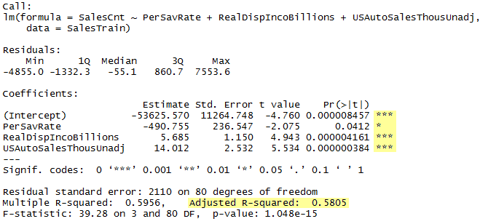
Predicting New BMW Sales – The Best Model

Slide 13
Predicting New BMW Sales – The Results
Split the data into a Training and Testing set
Training = 2007-2013; Testing = 2014-2016
Verified the results using Root Mean of Squared Errors (RMSE) & mean of Sales Count
RMSE of the Training Set = 2,059
RMSE of the Testing Set = 8,497
Mean of Sales Counts = 15,061
What it all means
The RMSE tells us how far off we could be with our predictions.
With the Training set, it’s a 13.7% span of error. So while the model may have predicted 20k for a particular month, the actual could be anywhere from 18k to 22k. Not too terribly bad.
With the Testing set, our error was more than 4x that of the Training set & had a span of 56% error. When using it for future months, if it had predicted 20k, the actuals could have been 11.5k-28.5k.
Conclusion: Our best model was not well suited to predict future sales.

Slide 14
Where to next…
Break down trends further by BMW Market
Do they mirror the Regional trends?
Vehicle Categories by Gender &/or Age (using birth date)
Limited data, but still look to see who’s buying what
Can help with target marketing
Repeat vs First-time Buyers
Review trade VIN data – converting from another brand (which ones) or repeat BMW buyer (same model series or upgrading)?
Length of Vehicle Ownership
Time between sales records

Slide 15
In Conclusion
BMW sales are steady and slightly increasing
New Sales are on the decline in recent years
Used Sales have been on the rise in recent years
Regional trends mimic National with Central being the lowest ranking
The 3-series is by far the largest seller, more than double the volume of the 2nd place 5-series
The 3-series is also the most moderately priced line, but the expensive X5’s outsell their more moderately priced X3 counterpart.
Predicting New BMW sales based on U.S. economic statistics has proven to be inadequate
In conjunction with the higher priced BMW’s & fairly high cash purchase rate, this could indicate that BMW buyers are upper class and not as influenced by the national averages and loan rates

